Slide 1
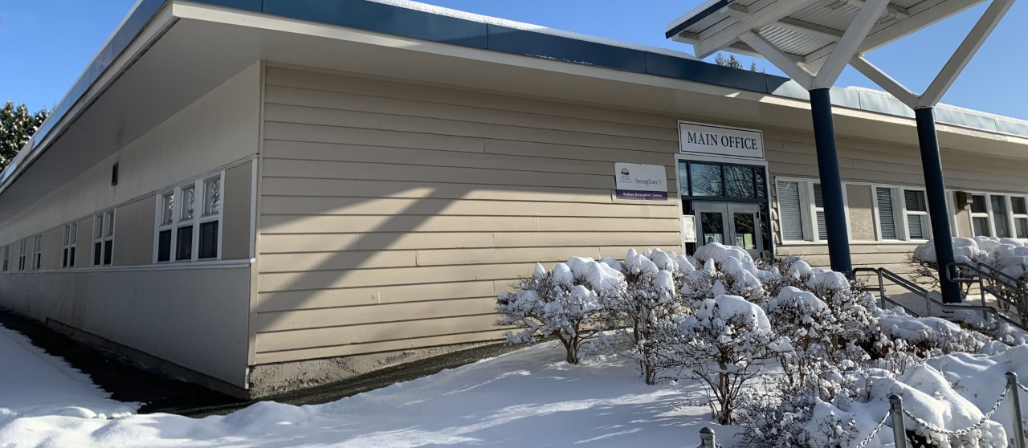
Godson Grizzlies Assembly
Monday
January 24, 2021

Slide 3
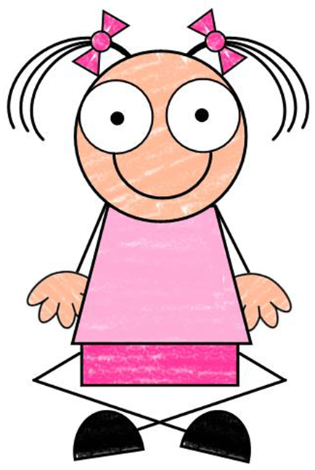
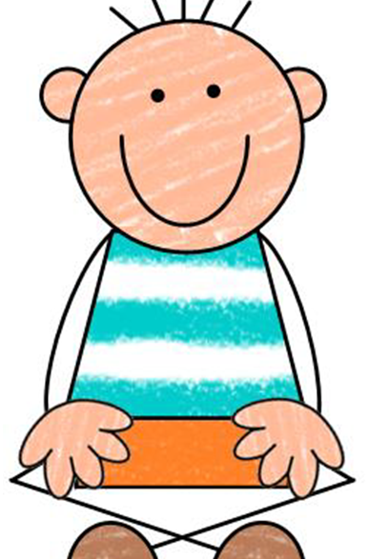
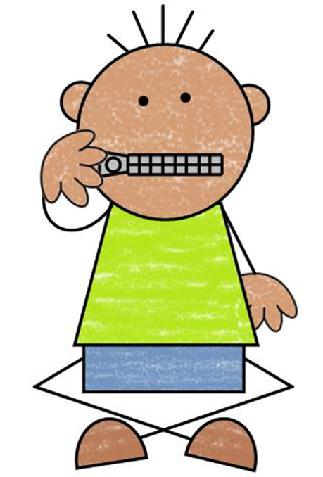
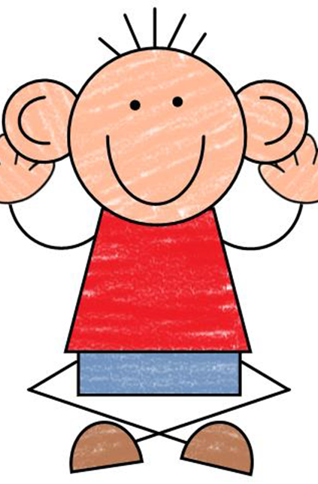
Give me 5
This is how we participate in an assembly…

Slide 4
O’Canada

Slide 5
Welcome Ms. DenOuden’s Baby!

Slide 6
Welcome New Staff
Mrs. Phillips – Vice Principal
Mrs. Belsher - Counsellor

Slide 7
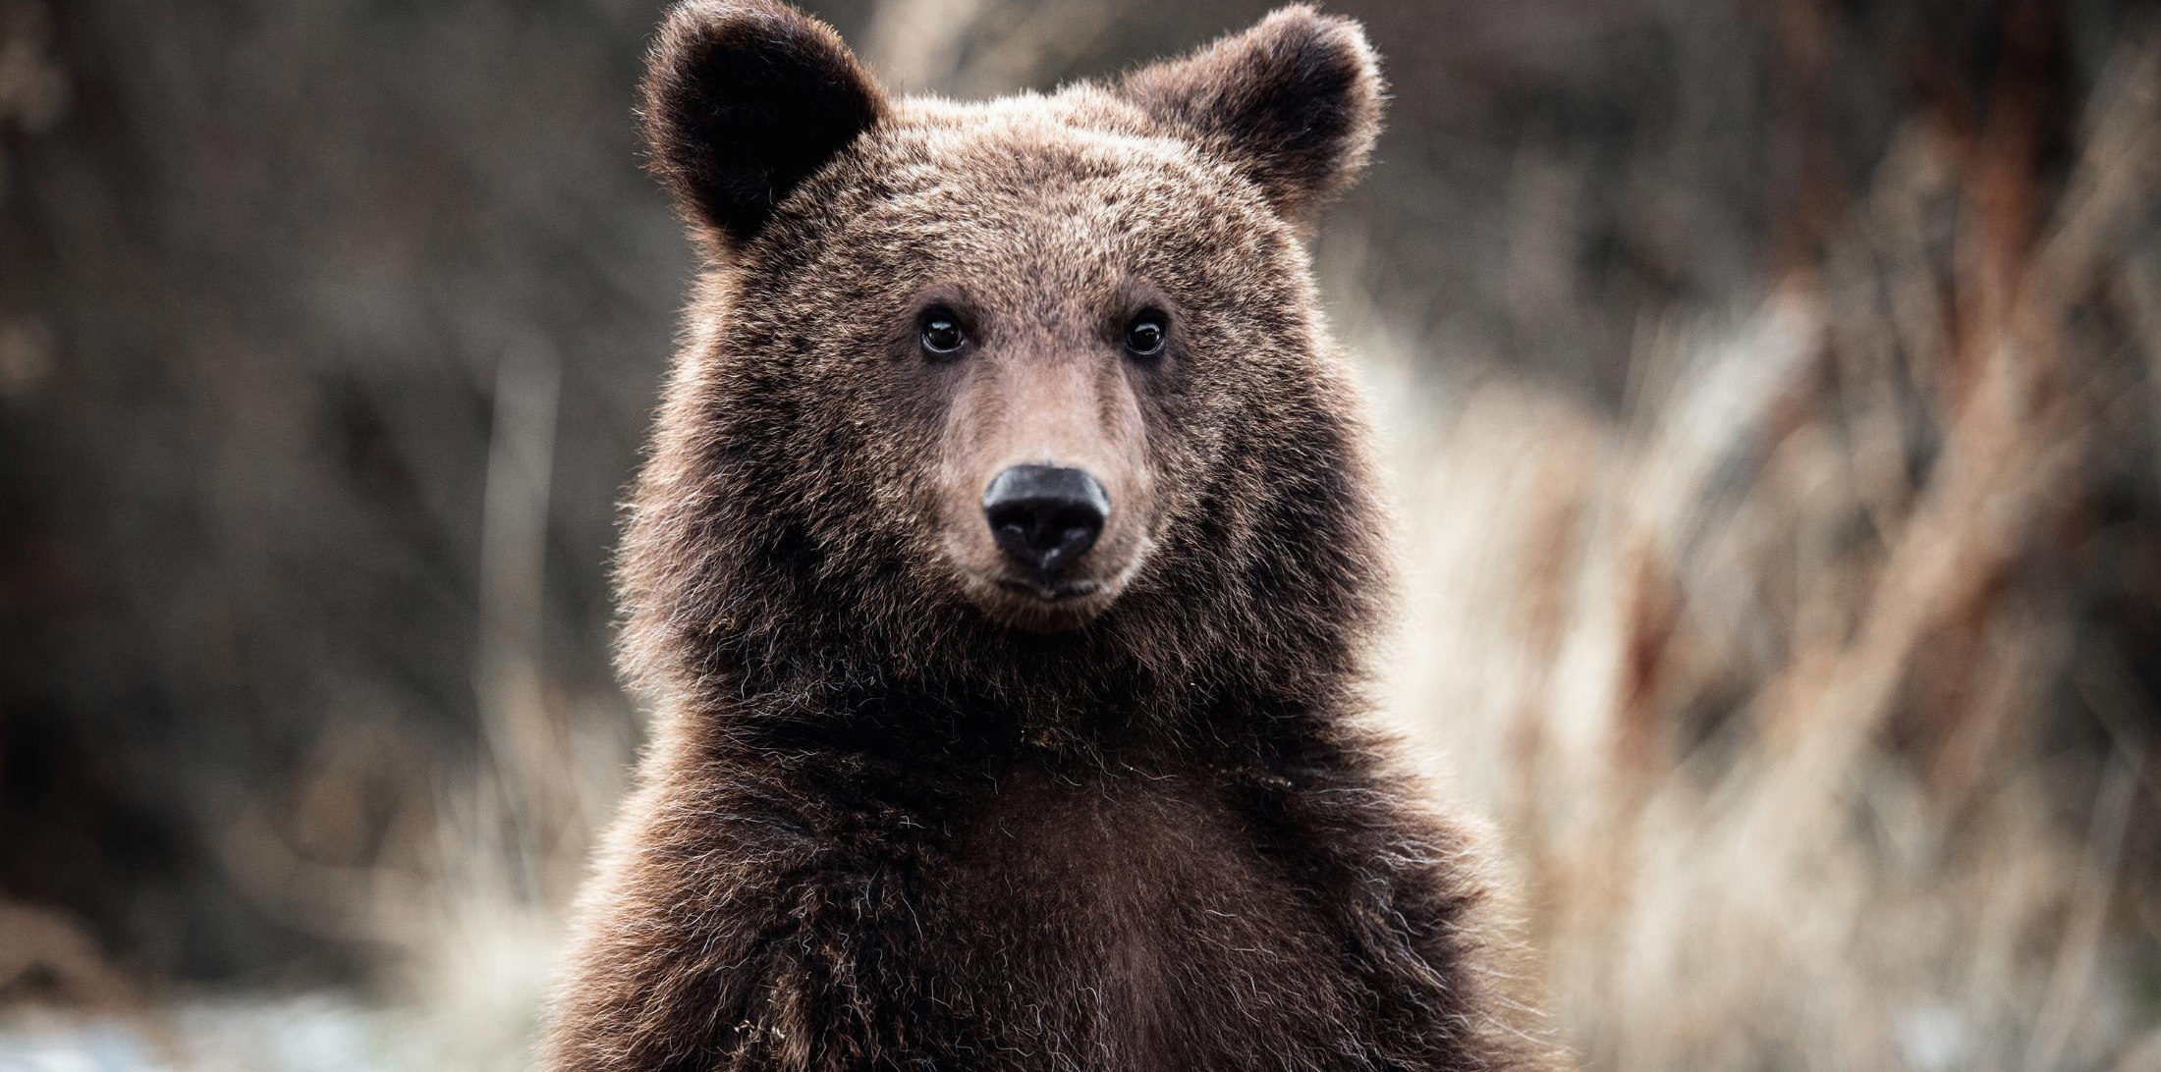
GODSON GRIZZLIES ARE:
Safe
Kind
Responsible

Slide 8
BE SAFE
Remember to wear your mask

Slide 9
Is someone bothering you?
Walk away
I gnore
T alk it out
S eek help
Use your WITS!

Slide 11
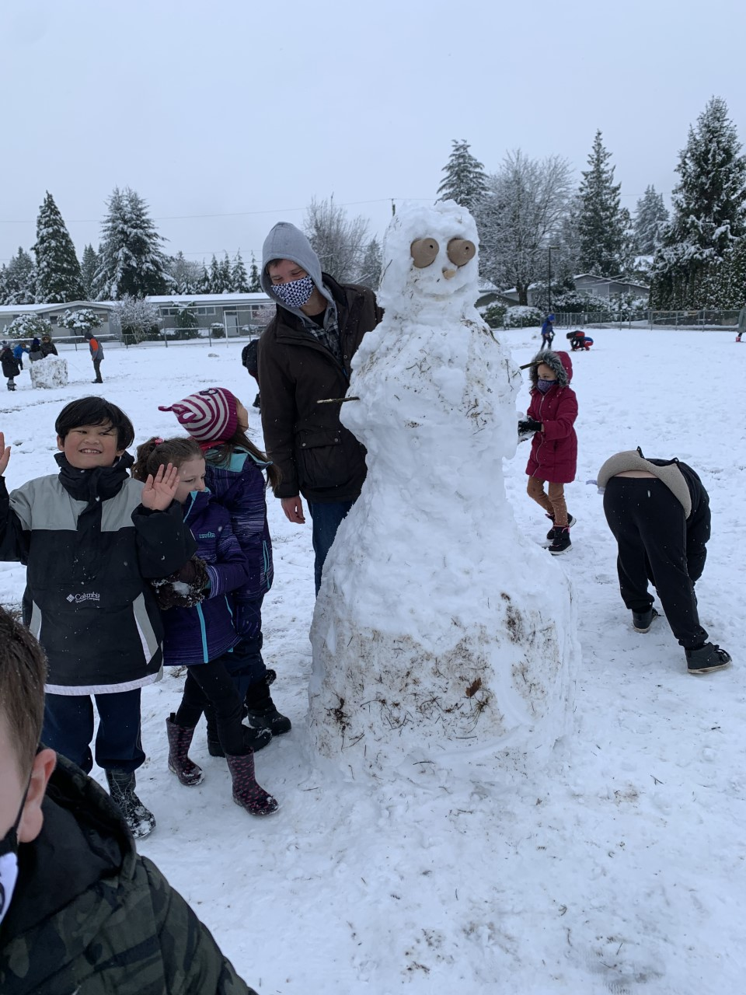
BE KIND
Playing together to create something amazing!

Slide 12
Washroom Expectations

Slide 13
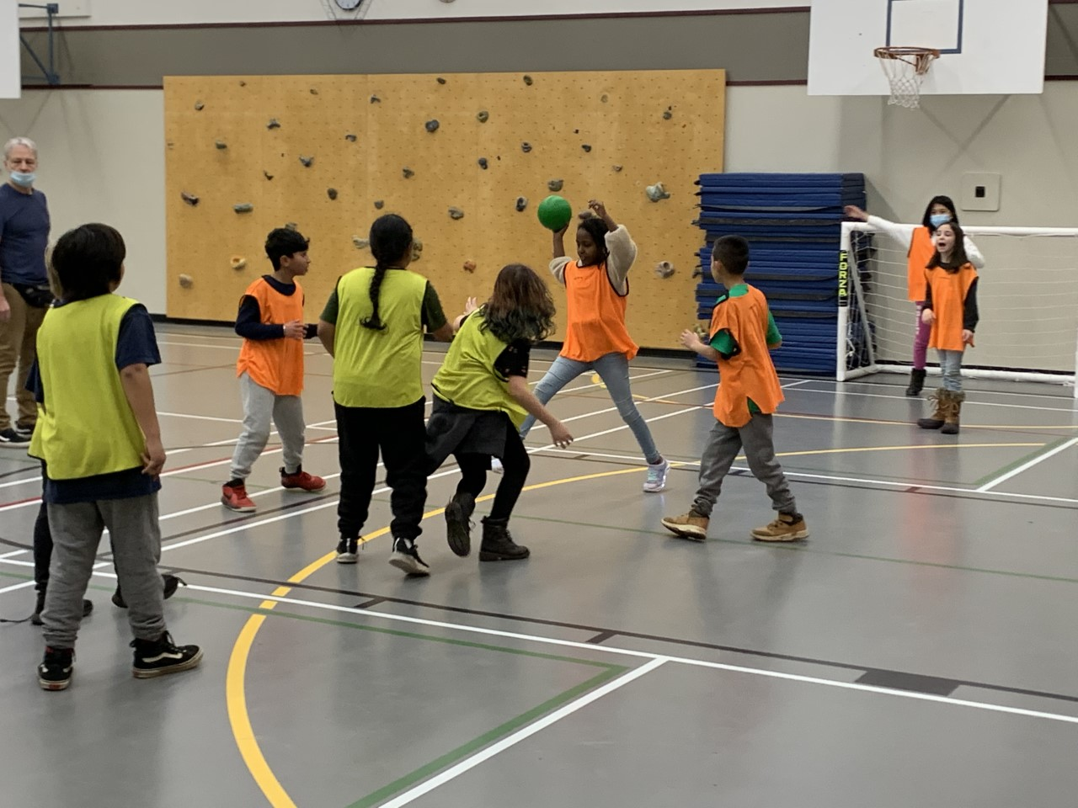
RESPONSIBLE
Playing by the rules so everyone has fun

Slide 14
Hallway Expectations
Remember to wait for the NHS to dismiss you to go outside at lunch.
BE PATIENT!

Slide 15
Safety

Slide 16
Safety

Slide 17
Safety

Slide 18
Safety

Slide 19
Safety

Slide 20
Upcoming Events
Fri., Jan. 28 – ProD Day – No school
Jan. 11- Mar 11 Grade 5 MDI student survey
Reptile Man is coming some day soon
Mon., Jan. 31 K registration begins
Tues., Feb. 1 – Chinese New Year
Mon., Feb. 14 Valentine’s Day
Mon., Feb. 21 Family Day
Wed., Feb. 23 Pink Shirt Day
Fri., March 11 Report Cards go home

